Slide 1
Project Ecommerce Analytics
By
Group 7

Slide 2
Group Members
Atharv Mahendra Yadav
Jayakumar Gopal Shetasanadi
Pratiksha Pandit Jadhav
Ragavan S
Vichithra B

Slide 3
Summary
Objective:
Goal: Analyze customer behavior, sales trends, and operational efficiency to inform strategic decisions.
Focus: Enhance customer experience and optimize business operations.
Dataset Details:
Type: CSV files
Number: 9 datasets
Content: Orders, payments, products, reviews, geolocation data
Expected Outcomes:
Actionable Insights: Identify trends and areas for improvement in customer satisfaction, payment methods, and logistics.
Strategic Recommendations: Inform targeted marketing strategies, optimize logistics, and enhance customer experience.

Slide 4
Key Performance Indicators (KPIs)

Slide 5
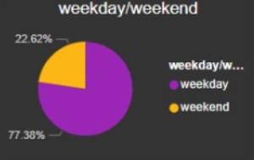
Weekday Vs Weekend Payment Statistics
This KPI compares the payment patterns and sales volumes during weekdays and weekends. It helps identify if there are significant differences in consumer behavior between these periods, which can inform marketing strategies and resource allocation.

Slide 6
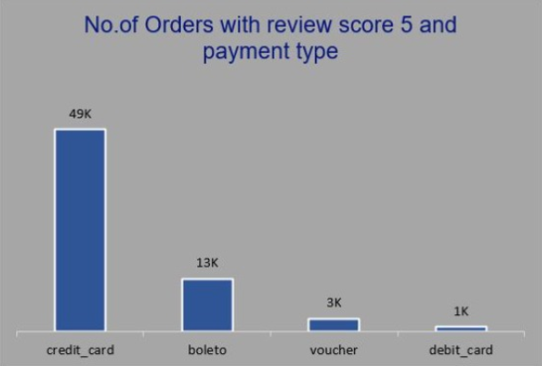
No. of Orders with Review Score 5 & Payment Type as Credit Card
This metric focuses on orders that received a perfect review score (5) and were paid using credit cards. It highlights the effectiveness of credit card payments in achieving high customer satisfaction and can guide payment method promotions.

Slide 7
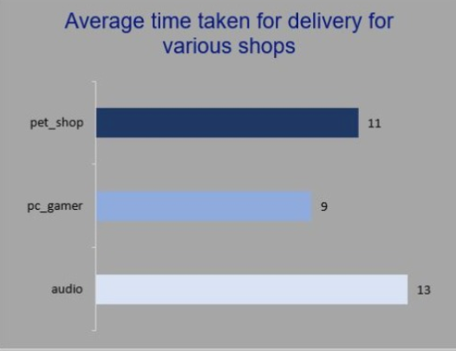
Average No. of Days Taken for Order Delivery for Pet Shop
This KPI measures the average time taken to deliver orders from the pet shop category. It helps assess the efficiency of logistics for pet products and identify areas for improvement to enhance customer satisfaction.

Slide 8
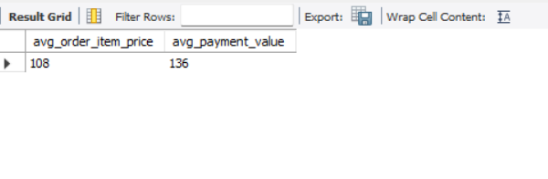
Average Price and Payment Values from Customers of São Paulo City
This metric analyzes the average transaction values and prices for customers based in São Paulo. It provides insights into regional purchasing power and can inform targeted marketing strategies for high-value customers.

Slide 9
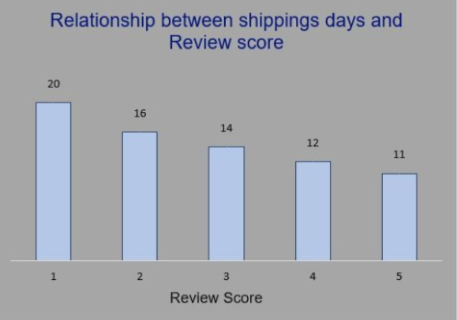
Relationship Between Shipping Days and Review Scores
This KPI examines how the number of shipping days affects customer review scores. It helps understand the impact of delivery speed on customer satisfaction and can guide improvements in logistics to enhance overall customer experience.

Slide 10
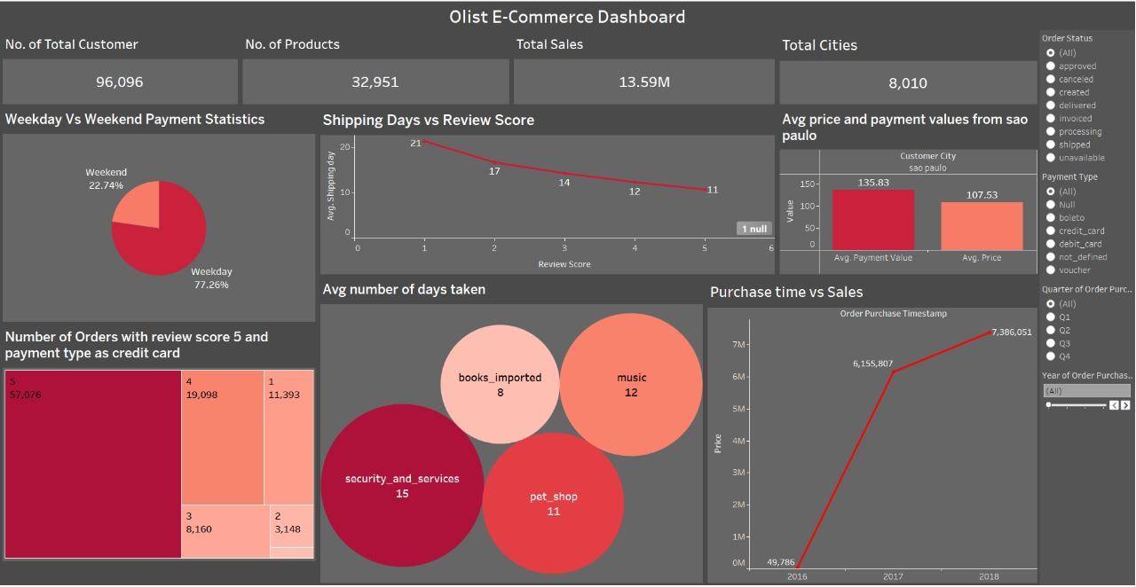
TABLEAU DASHBOARD

Slide 11
Key Insights
90% delivery success rate (89,940/99,440 orders delivered).
Average product rating: 4.09/5, with categories ranging from 2.5 to 4.67.
1-star reviews ranked third in distribution, indicating quality issues in specific categories.
São Paulo housed the highest-value customers, influencing targeted marketing strategies.
Weekend sales lagged behind weekdays, suggesting opportunities for promotions

Slide 12
Conclusion
The Olist Store Analysis project provided comprehensive insights into customer behavior, sales trends, and operational efficiency for the Olist e-commerce platform.
Enhanced Customer Experience: Faster shipping times significantly improve customer satisfaction, as evidenced by higher review scores.
Payment Preferences: Credit card payments are associated with higher customer satisfaction, suggesting targeted promotions could increase overall satisfaction.
Regional Insights: São Paulo customers have higher average transaction values, indicating potential for targeted marketing strategies.
Operational Efficiency: Pet shop delivery times can be optimized to reduce average shipping days.

Slide 13
Thank you

